Slide 1
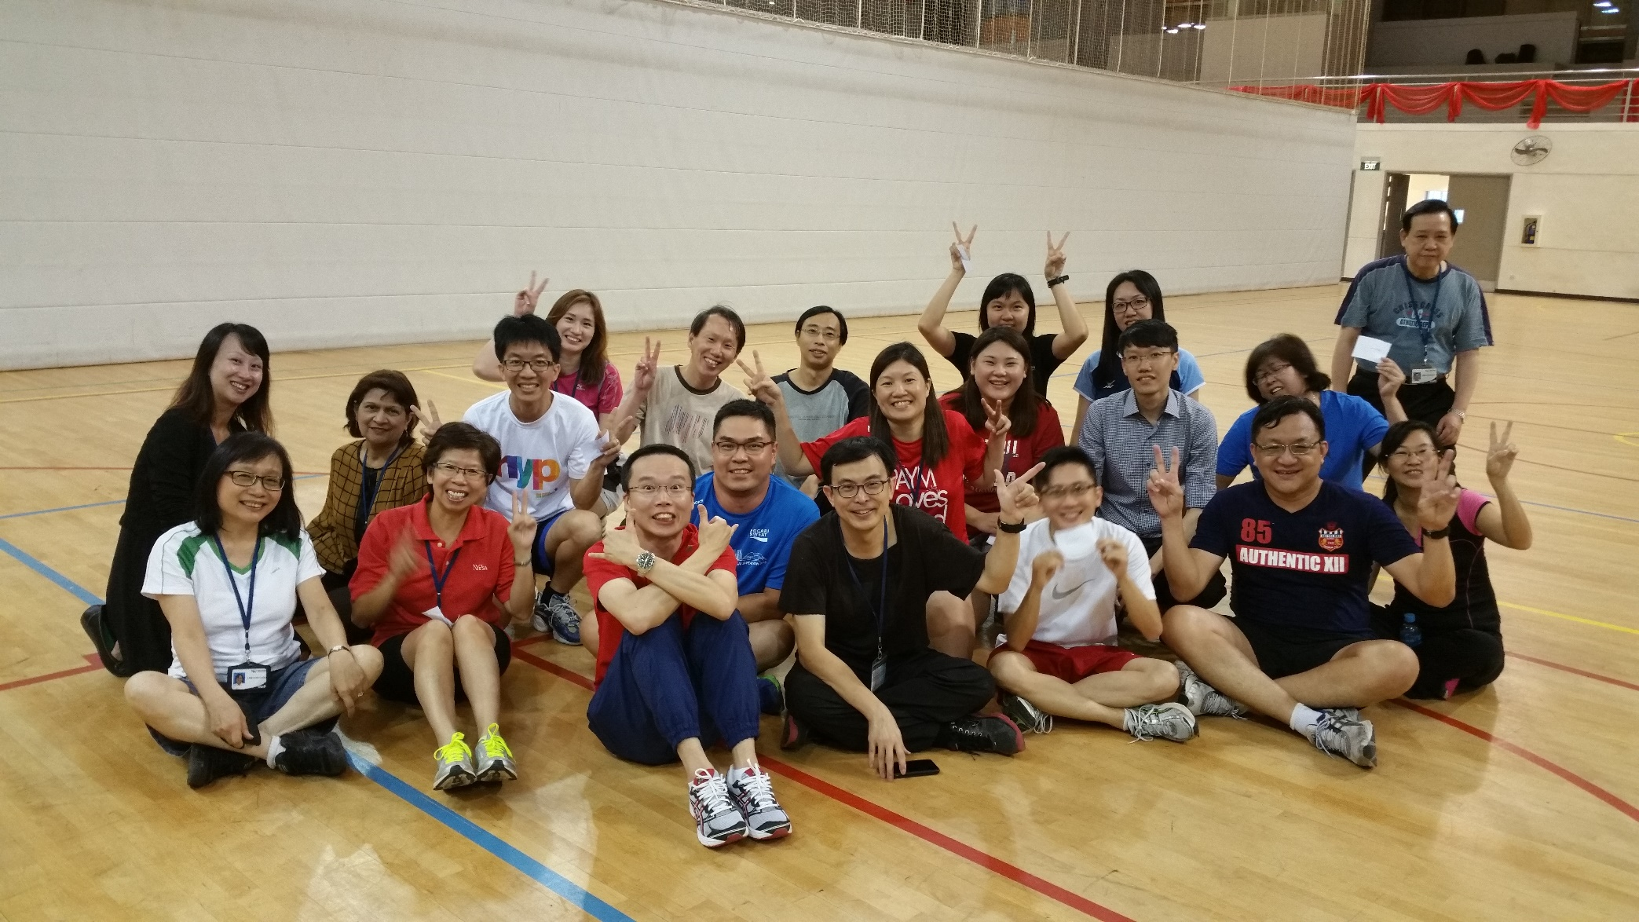

Computer & Network Center (CNC)
Infra, Info System and Security Services Overview
Staff Induction

Slide 2
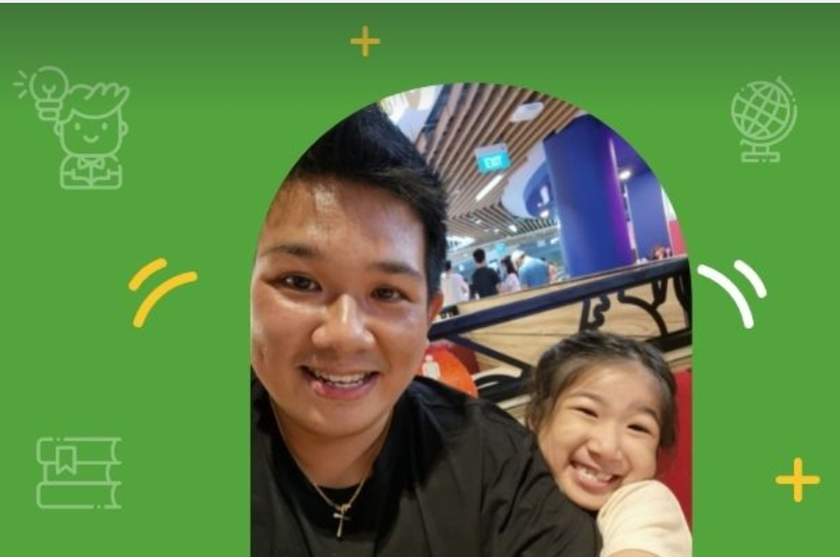
About Me
Asst Director, ICT Governance, Cybersecurity & Digital Workplace
ACISO (Agency Chief Information Security Officer)
Contact Me
Email: thomas_chia@nyp.edu.sg
Ext 0270
LinkedIn: https://www.linkedin.com/in/thomaschiahk
NYP Security Team
Email: nyp-cnc-security@nyp.edu.sg
Helpdesk 6550 0099
Notes:
Hello Colleagues, Welcome Aboard Team NYP Name is Thomas / Hong Kit. Don’t call me HK la hor….the word association not very nice
I lead the Cyber Security Team in CNC together with 3 other colleagues. There’s another Thomas in CNC, Thomas Kua so please don’t get mixed up
I just joined NYP in Dec 2021 so im 5 months old. I was previously from DBS
Looking forward to work with you in the coming days hopefully…
Security issues email us or call me
Issues with your GFE issued devices, or accounts please call helpdesk.

Slide 3
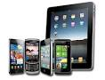






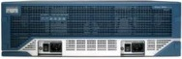
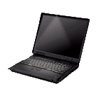

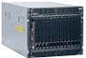

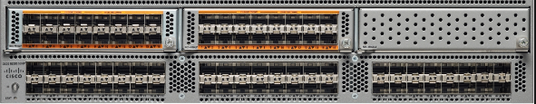



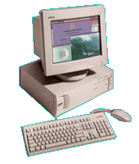
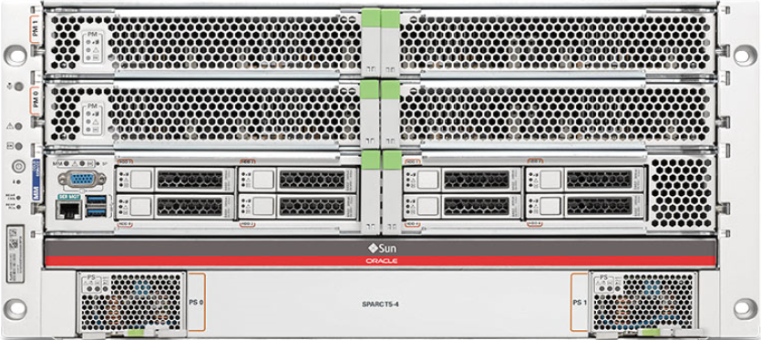

NYP’s ICT Infrastructure Overview
Video Conference + Teams Telephony
Wireless on WiFi6
M365 +Exchange
Online
NYP 10G MPLS
Network
(Virtualisation Infra + GCC)
Staff
Student
Govt Intranet
Windows
Applications
Windows 10
GeBiz
Internet
2000Mbps
6 Gigabit link
10Gbps
e-Learning
2 Gigabit link
(Virtualisation Infra)
Broadband
4000Mbps
Global Switch
VPN
NYP Info System,
Student e-Services
2000Mbps
Internet

Slide 4
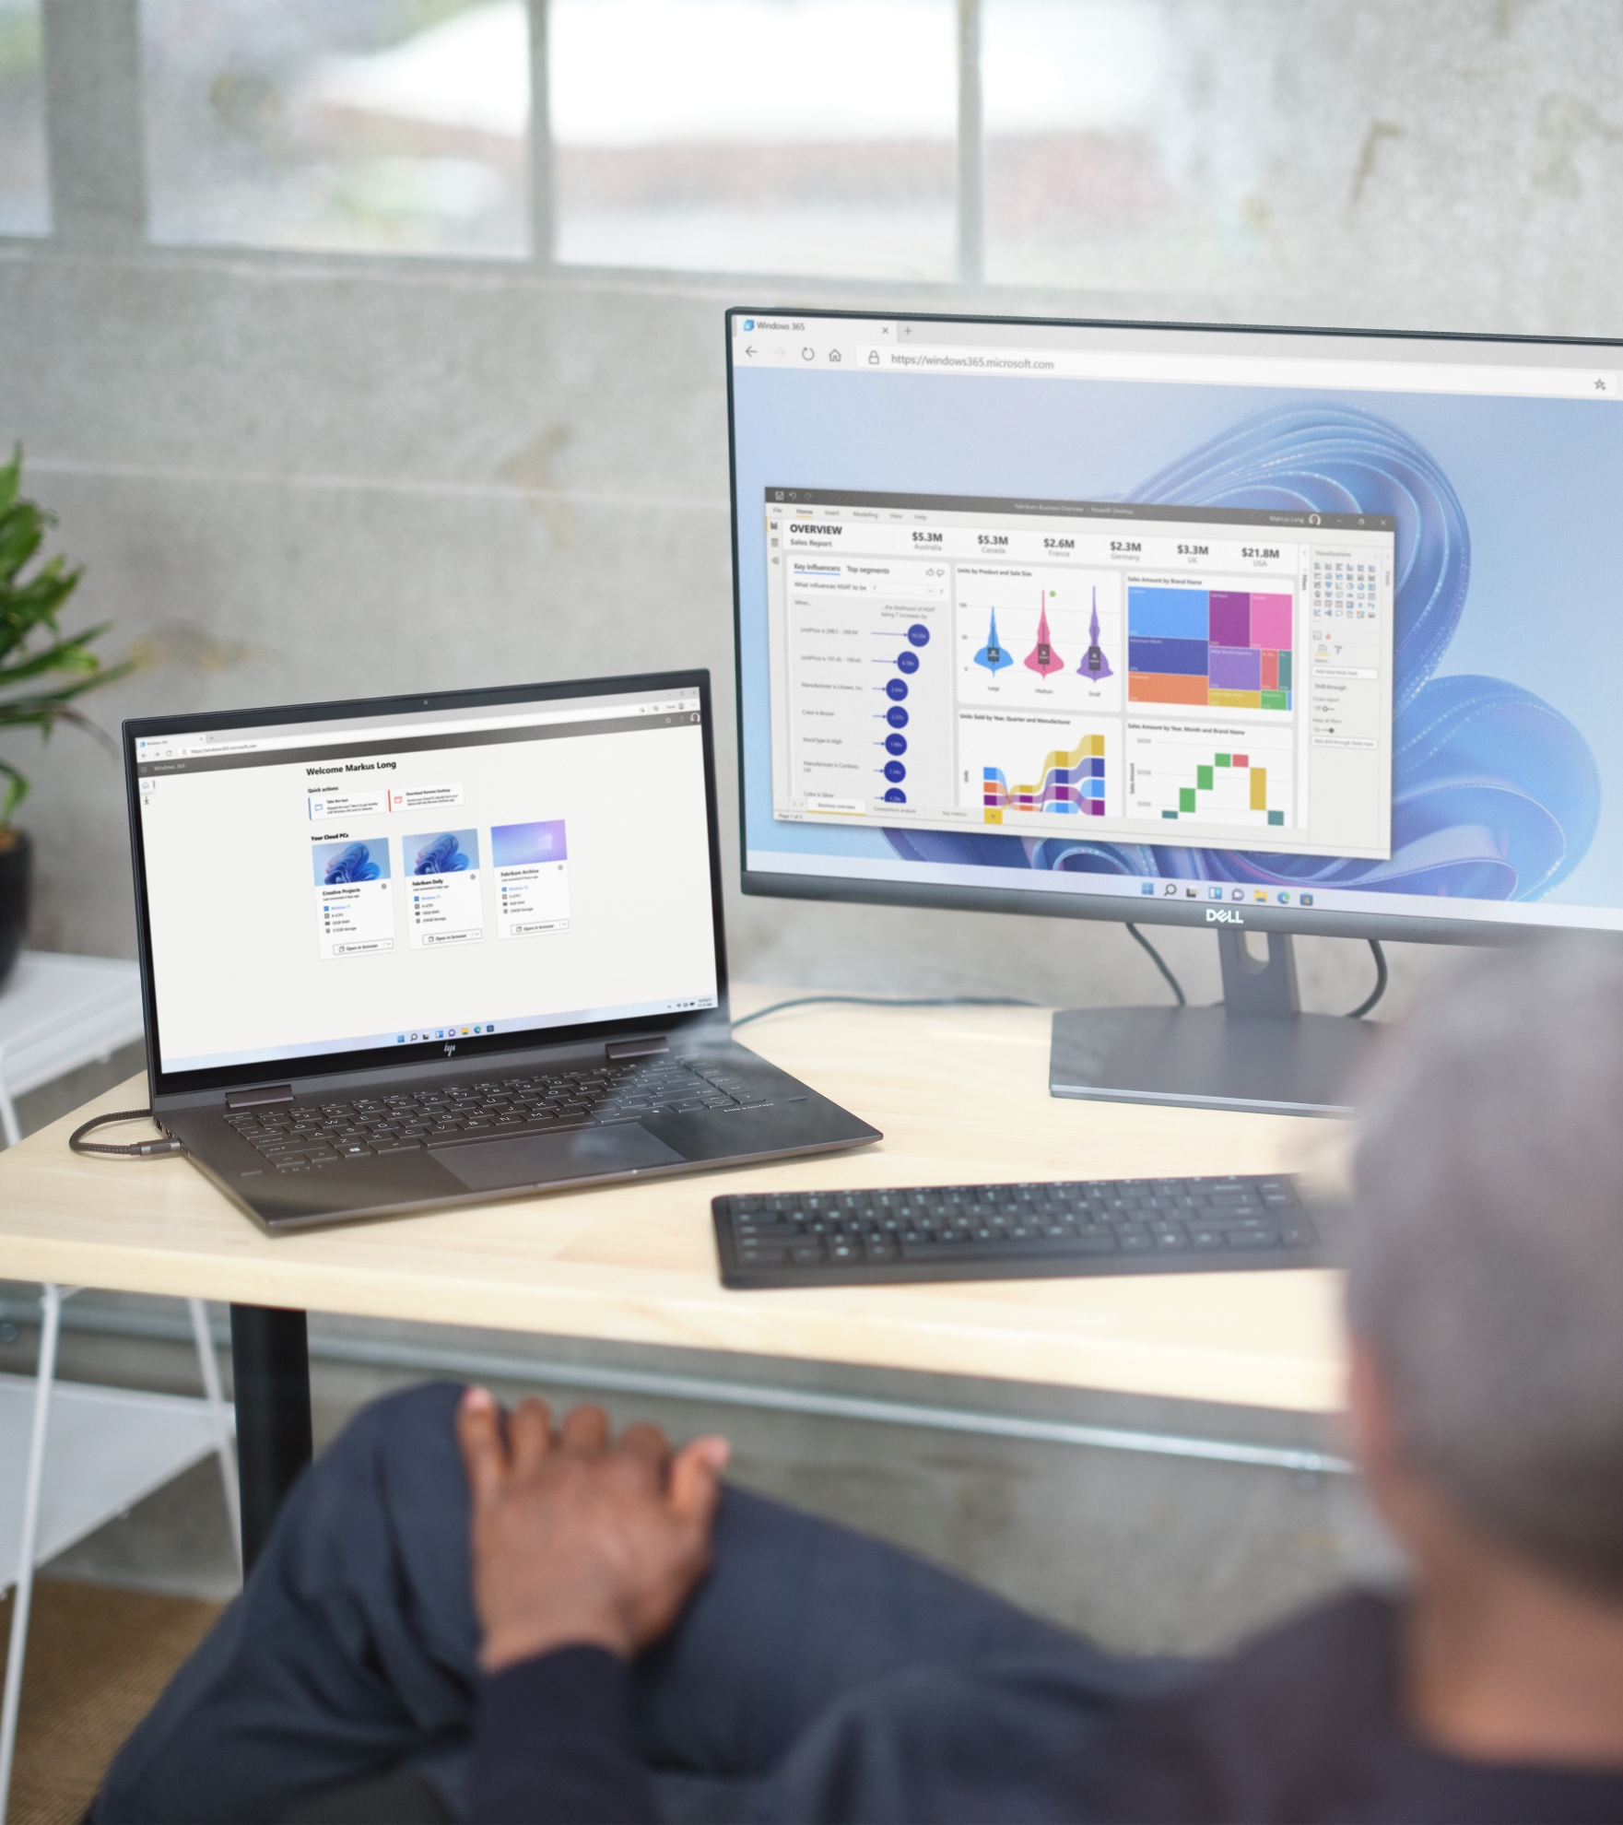
Future of Workplace - What your desk will look like soon
6. 27” Monitor
Choose your BYOD
Cloud PC
Teams Telephony
WIFI 6
Cloud VPN
Notes:
Choose your own BYOD, we want to give you a choice to choose with device do you want to use, with this, it also means that we are moving away from passwords, using face and fingerprints for logon,
Cloud PC – always on machine in the cloud to use, a highly secured space for you to work anywhere

Slide 5

Cloud PC
Personalize your Cloud PCs
Setup your Cloud PC to use your preferences
Changes made will remain in place between sessions
Combine the power and security of the cloud with the versatility and simplicity of the PC.
Take it with you
Use your Cloud PC from any desktop or tablet, anywhere around the world
Accessing your Cloud PC won’t make changes to the host computer
Your data is protected
All your files and programs are secured
Regular backups and patching automatically performed

Slide 6
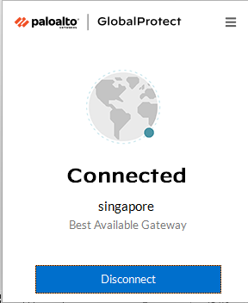
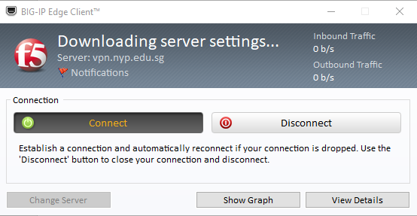
Cloud VPN
Simplified experience, click connect > MFA > done!
Continuous monitoring, we can quickly identify and respond when something is slow
Better security with Continuous verification & Inspection

Slide 7
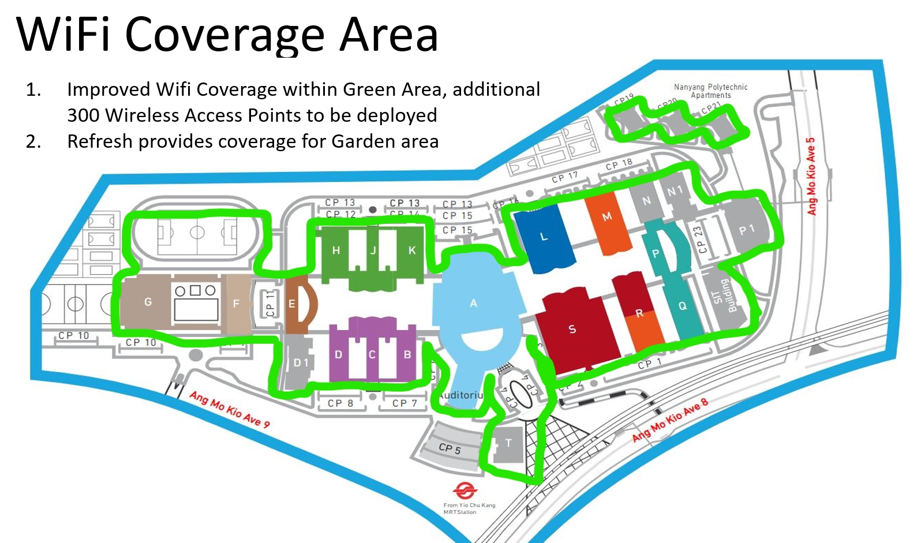
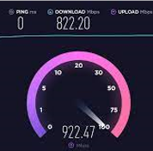
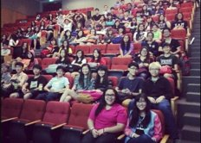
WIFI 6
More stable wifi
Faster Access
Speed
Improved Campus Coverage with increased 400 AP (2300 -> 2700)
Notes:
Garden area, P1, WIFI better and faster (3G to 5G)

Slide 8
Acceptable Use Policy
The responsibility for proper and safe usage of ICT resources such as but not limited to Endpoint Devices, Email, Internet and Network systems in Nanyang Polytechnic (NYP) as well as Whole-of-Government (WOG) environment, requires the cooperation of every officer, as any security breach on the part of individual officer can undermine the security of the entire organisation.
Some important points to note
NYP shall have the right to access and disclose staff data stored on Government Furnished Equipment (GFE) and Email messages of staff.
NYP shall have the right also to control, monitor and disclose staff use of NYP IT resources.
Staff shall read through and observe closely the following Policies on Electronic Mail, Endpoint Devices, Internet Access, and access to Government Enterprise Networks (GEN).
Users shall be accountable for their passwords and not disclose their user accounts and passwords to others.
Passwords shall be compliant with NYP Password Standard and Guidelines.
Users shall ensure they keep themselves updated with the latest version of the Acceptable Use Policy of IT Resources.
Please read through the full Acceptable Use Policy here.
Visit NYP ICT Policies for other policies

Slide 9
Cybersecurity Awareness - Phishing
What is Phishing?
Phishing is a cybercrime in which a target or targets are contacted by email, telephone or text message by someone posing as a legitimate institution to lure individuals into providing sensitive data such as personally identifiable information, banking and credit card details, and passwords. The information is then used to access important accounts and can result in identity theft and financial loss.
Common Features of Phishing Emails
Too Good to be True
2. Sense of urgency
3. Hyperlinks
4. Attachments
5. Unusual Sender

Slide 10
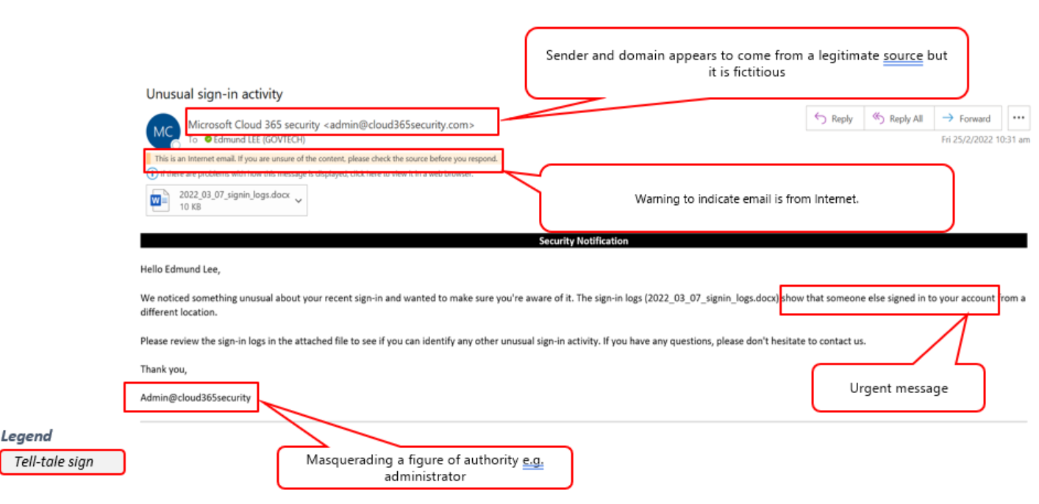
Cybersecurity Awareness - Phishing
Example of a Phishing Email

Slide 11
Cybersecurity Awareness - Phishing
It can be really difficult sometimes to spot a phishing email….
How to stay safe when you receive an unsolicited email?
Ask yourself the following
Do you know the sender?
Did you request for the information?
If you know the sender, call the sender to verify if the email was indeed sent by him.
Why is there an urgency?
What is it asking me to do?
Do not click on URL links in emails or text messages. Hover your mouse over the link to see destination URL, if it is legitimate.
Do not share sensitive and personal information without verification
Never share confidential information such as OTPs or passwords with anyone.
REMEMBER: ALWAYS THINK BEFORE YOU CLICK. Report it if you are unsure.

Slide 12

Incident Management
Staff reports to ISWG immediately.
ISWG works closely with SIROs.
SIROs must have oversights of all incidents discovered by members of the public (MoP), monitoring tools and NYP stakeholders (Staff, Learners, etc...)
SIROs provide status updates to ACISO/ASO.
ICT and Security WorkGroup (ISWG)
Representatives | Name | Email | Contact
ACISO | Thomas Chia | thomas_chia@nyp.edu.sg | 6550 0270
CORP / SIRO | Jeffery Tay | jeffery_tay@nyp.edu.sg | 6550 0059
CORP / SIRO | Nelson Choo | nelson_choo@nyp.edu.sg | 6550 1993
CORP / SIRO | Ryan Villegas | ryan_villegas@nyp.edu.sg | 6550 0260
ACI | Gwey Soon Seng | gwey_soon_seng@aci.edu.sg | 6417 3047
SAS | Kelvin Tan | kelvin_tan@nyp.edu.sg | 6550 1531
SBM | Chan Kok Hong | chan_kok_hong@nyp.edu.sg | 6550 1228
SDM | Andrew Lam | andrew_lam@nyp.edu.sg | 6550 1748
SDM | Alan Tan | alan_tan@nyp.edu.sg | 6550 1821
SEG | Yeo Boon Pu | yeo_boon_pu@nyp.edu.sg | 6550 1815
SEG | Michael Wee | michael_wee@nyp.edu.sg | 6550 0870
SHSS | Ong Wei Guang | ong_wei_guang@nyp.edu.sg | 6550 1945
SHSS | Lee Teck Meng | lee_teck_meng@nyp.edu.sg | 6550 1330
SIRS | Johnson Tan | johnson_tan@nyp.edu.sg | 6417 3004
SIT | Sunny Sin | sunny_sin@nyp.edu.sg | 6550 1728
SIT | Huang Wan Ling | huang_wanling@nyp.edu.sg | 6550 1738
SIT | Lawrence Tham | lawrence_tham@nyp.edu.sg | 6550 1711

Slide 13
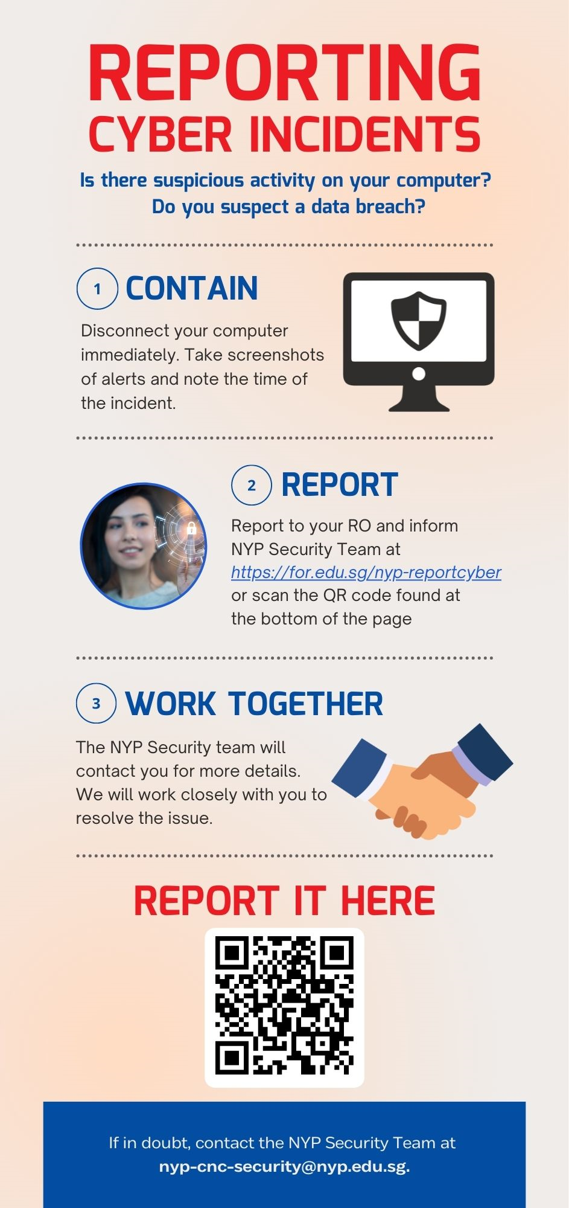
Incident Management
It is important to stay calm if you encounter a suspected security incident and report the incident to the right people, through the right channels.
Always remember to:
Stay calm and disconnect your computer from the network.
Gather any evidence you can and report to your RO and inform NYP Security Team https://for.edu.sg/nyp-reportcyber
NYP Security Team will contact you and work closely with you to resolve the issue

Slide 14
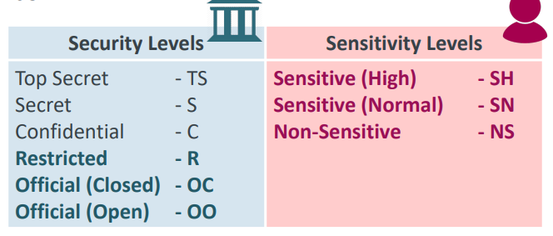
Data Classification
Why do we need perform Data Classification?
Data is at the core of the Digital Transformation of the Public Sector. We must use,
Share and safeguard data entrusted to us. Safeguarding the data that we use and share
is vital to the public’s trust in the Government’s use of data.
REMEMBER: Every office is responsible for the data they use and that is shared with them
Why do we need to classify and mark official information?
Classifying and marking official information is to highlight the presence of classified
Information and to ensure that the classified information is protected with the appropriate
Safeguards.
For more information visit Using Data Securely.pdf (sharepoint.com)

Slide 15
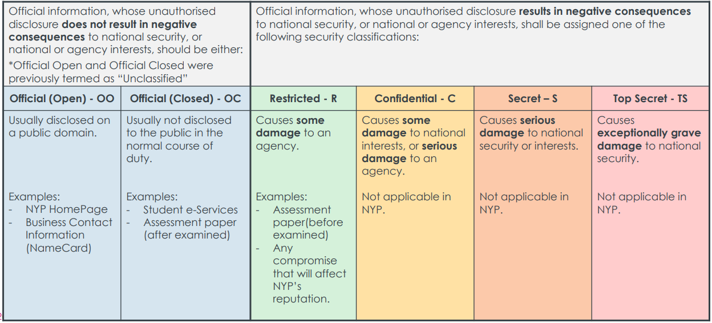
Understanding the Security Levels
Security levels measure the damage done to an agency and/or national security and interests

Slide 16
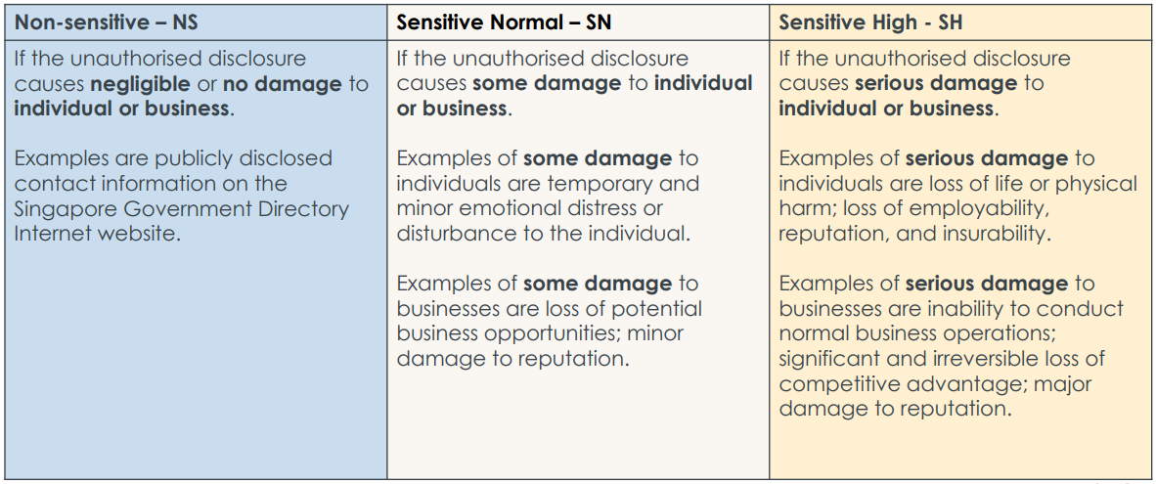
Understanding the Sensitivity Levels
Sensitivity levels measure the damage done to an entity (individual and/or business)

Slide 17
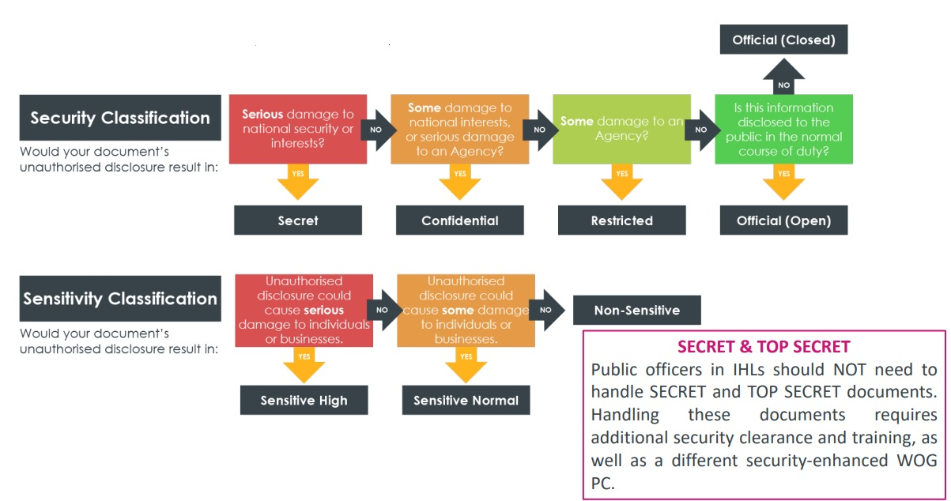
Decision Flowchart

Slide 18


Slide 19


